Slide 1
Strat of the Ages
Christian Bravo
Justin Lawrence

Slide 2
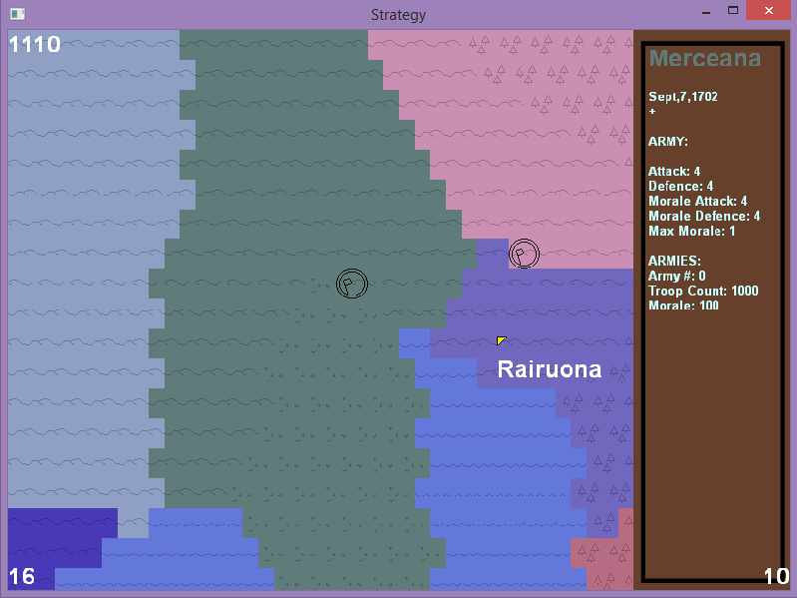
Description
Real-Time Strategy (RTS)
Control a nation
Gather resources
Purchase new troops
Purchase multiple armies
Declare war
Fight other armies
CONTROL THE WORLD

Slide 3
Group Dynamics
Christian
Late Design
AI(Early)
Functions(Economy related)
Balance
Justin
Early Design
Map Generation
AI(Late)
Functions(combat/movement related)

Slide 4
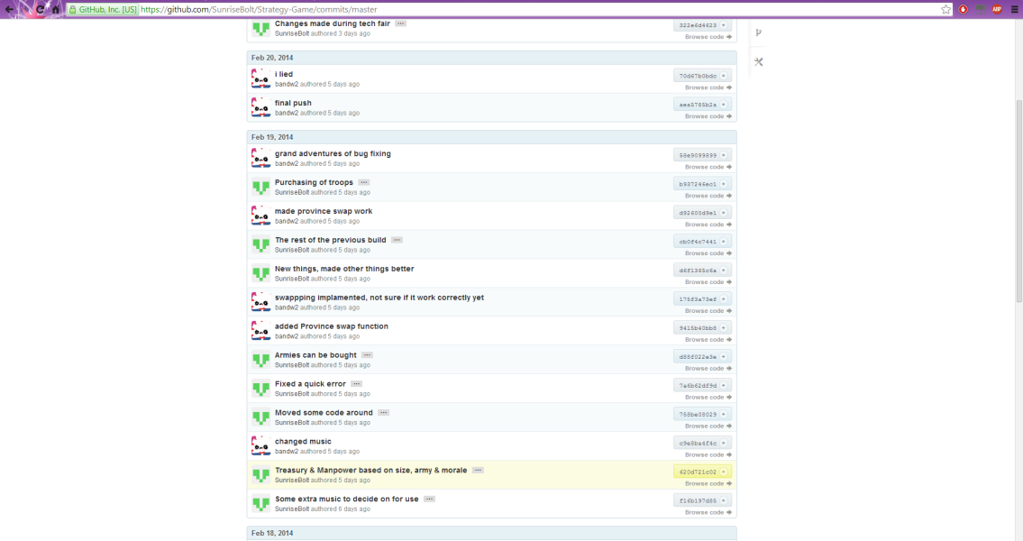
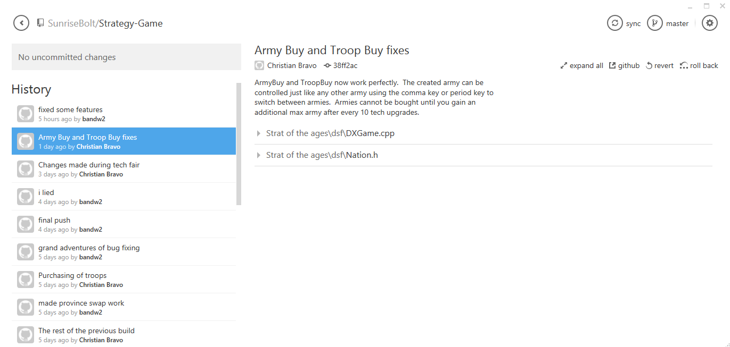
Version Control
Github.com
Git for Windows

Slide 5
Demo

Slide 6
Lessons Learned
Don’t be afraid to plan again
Missing details will bite you
Don’t think, Just Do
Specifics can wait, get functionality in

Slide 7
Questions
?

Slide 8
Thank You

